Slide 1
Hospital management system
عمل الطلاب
ابراهيم محمود ابراهيم موسي
مصطفي صابر محمد سيد
هشام صلاح يونس عبدالوارث

Slide 2
The overview
Our program can be used to manage a hospital system
Such that :
The program has implemented by linked list and contain four functions:
Add function :
to add a new patient in the list.
Search function :
to search if the patient is exist in the list or not.
Update function :
to change the information of the patient.
Delete function:
to remove the patient from the list.

Slide 3
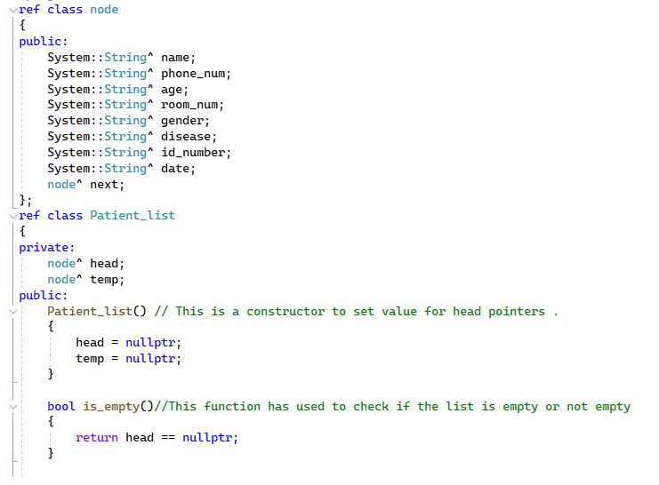

Slide 4
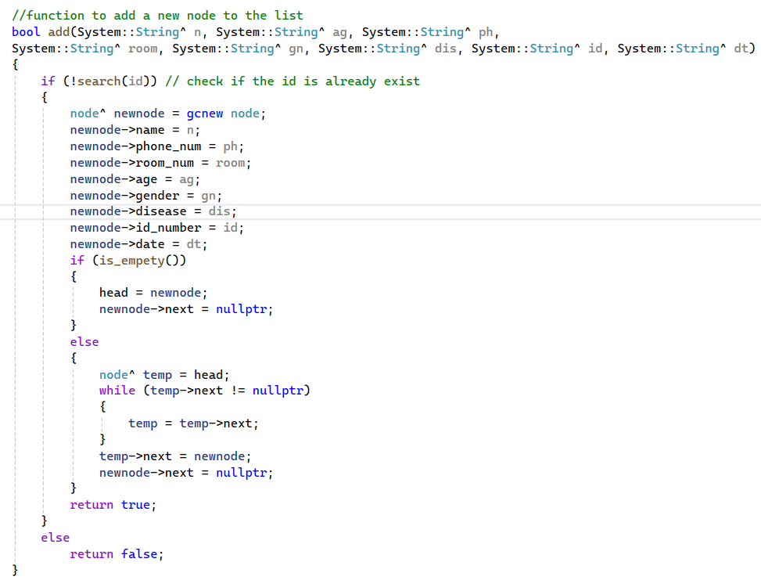
Add function
Take the parameters.
Check if the patient is already exist.
If the patient was exist don’t add the patient return false.
If the patient wasn’t exist ,add the patient and return true.

Slide 5
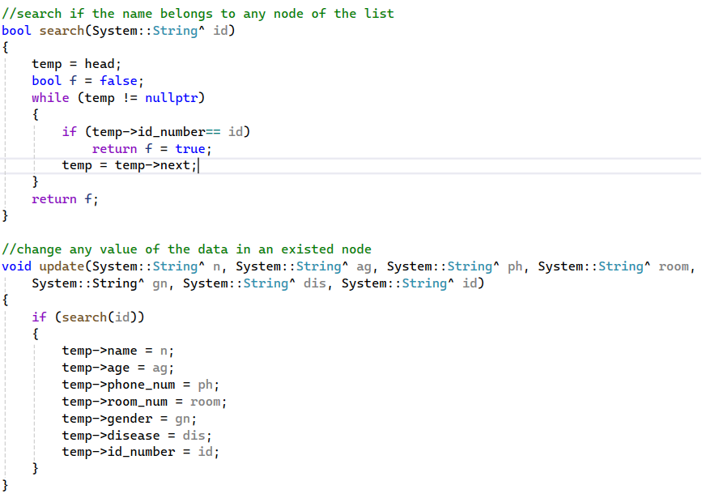
Search & update function
Search function :
* take the ID from the user .
* check if the ID exist in the list
return true .
* otherwise return false .
Update function :
* call search function to check.
* if exist update the information.

Slide 6
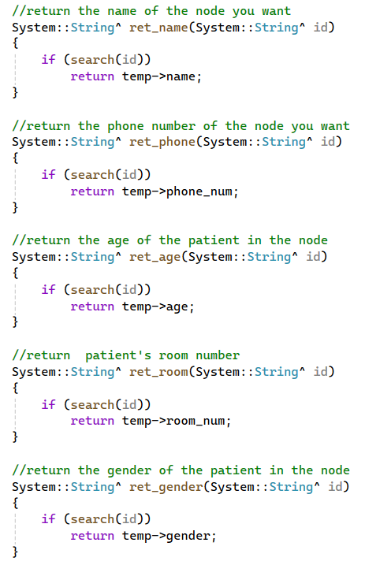
Return functions
Check if the patient is exist.
Return specific data.

Slide 7
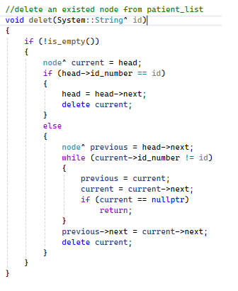
delete functions
Check if the patient is exist.
Delete the patient.

Slide 8
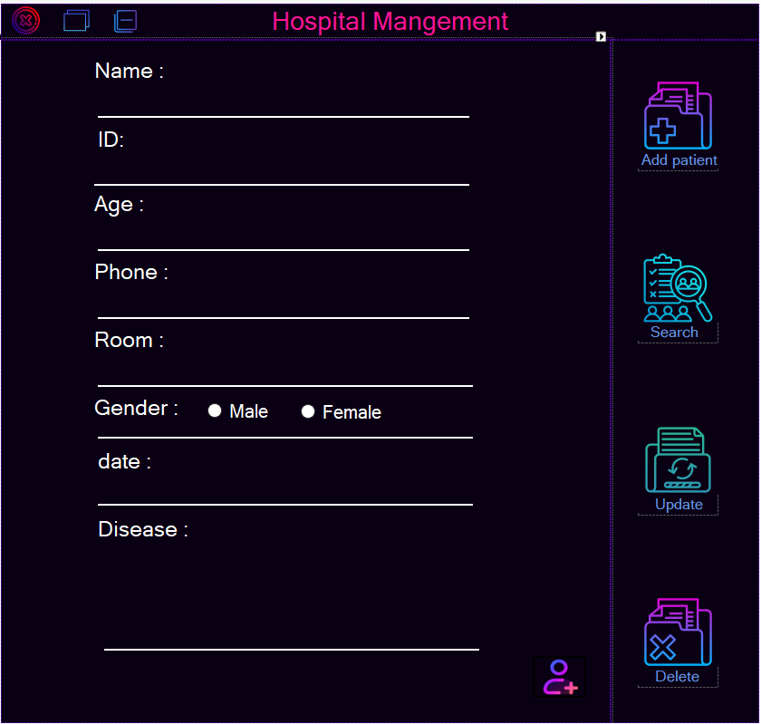
Add panel
Show when we click add patient Button
Fill out the form with the patient information
Click add button to add the patient to the list

Slide 9
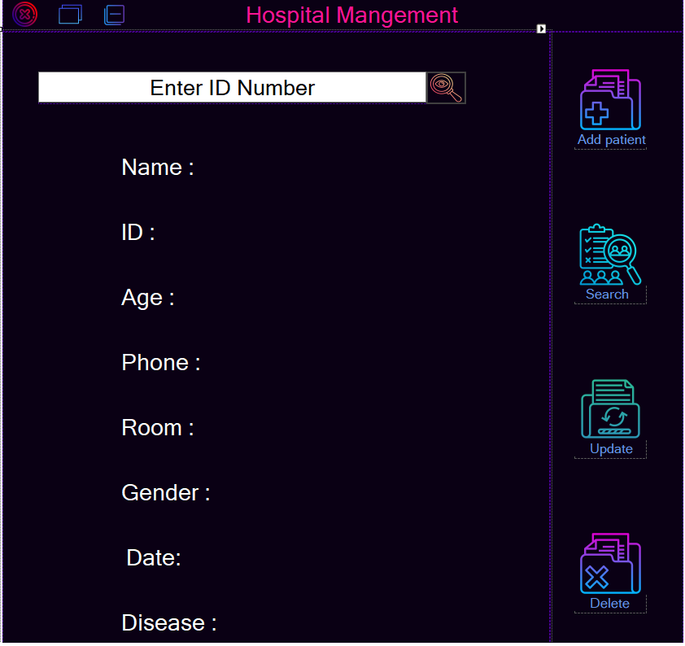
Search panel
Shown when we click search button
Enter the ID number to search for a patient
When we click on search button if the patient was exist show his information

Slide 10
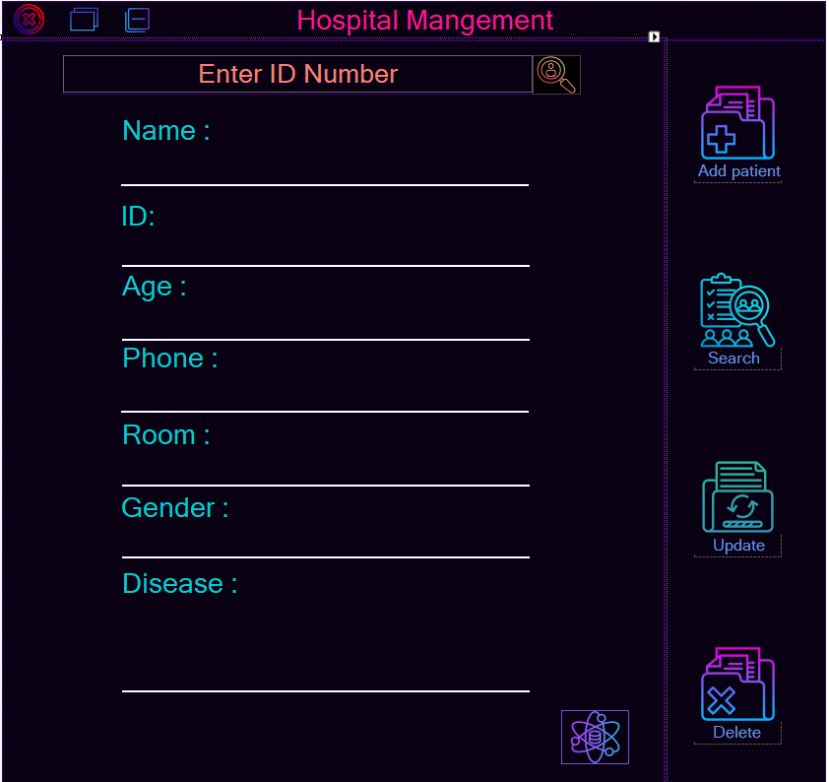
Update panel
Shown when we click update button
Enter the ID number to search for a patient
When we click on search button if the patient was exist show his information
Fill out the form with the patient data you want to change
When we click update button update patient data

Slide 11
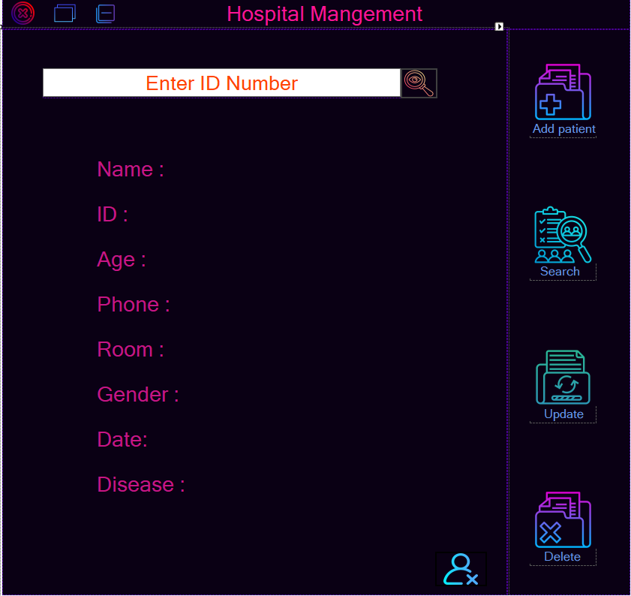
Delete panel
Shown when we click search button
Enter the ID number to search for a patient
When we click on search button if the patient was exist show his information
When we click on the delete button
delete the patient from the list

